Slide 1


Web Design
FINAL PROJECT
Group:
Tran Dinh Duy - Nguyen Quang Hao - Nguyen Tuan Dung - Nguyen Quynh Nhi

Slide 2
OUTLINE
01
02
03
Underlying technologies used
User experience
The administrator functionality

Slide 3



1
TECHNOLOGY USED

Slide 4

TECHNOLOGY
PHP
Google Font
Jquery Slider Component
Jquert Waypoint
Boostrap for CSS
Data Table
MD5 to encrypt password
Hosting by 000webhost
Jquery Counter
Font-Awsome

Slide 5

2
USER
EXPERIENCE
http://modaivyrichardfinalproject.onlinewebshop.net/
CHECKLIST

Slide 6
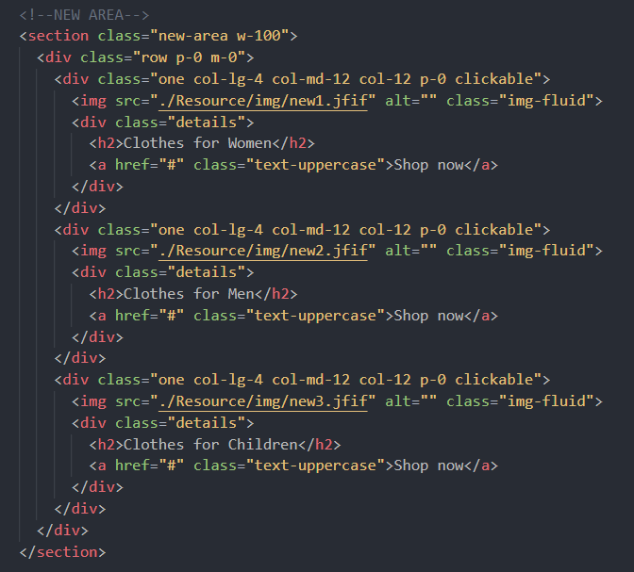
HTML & CSS
Move to BootStrap for CSS

Slide 7
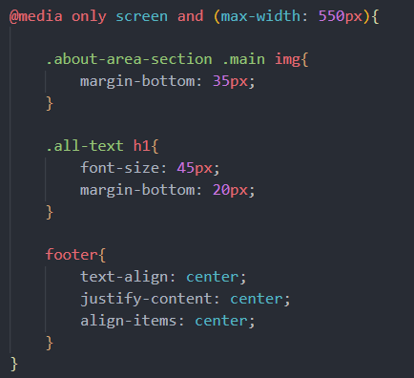
HTML & CSS
Flexible design for both mobile and computer screen

Slide 8
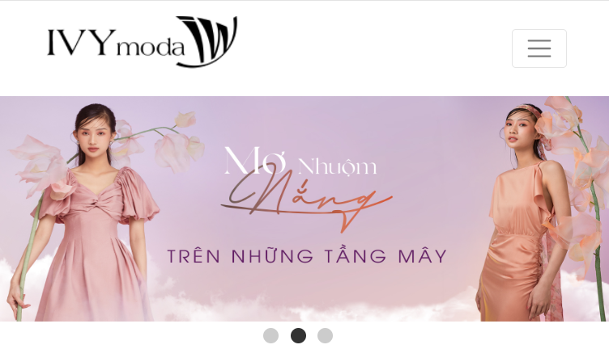
HTML & CSS
Flexible navigation bar,
transforming to menu when being in mobile design

Slide 9

3
BACK END
with
- Login
- Order Tracking
- Product Listing
- Product Management

Slide 10
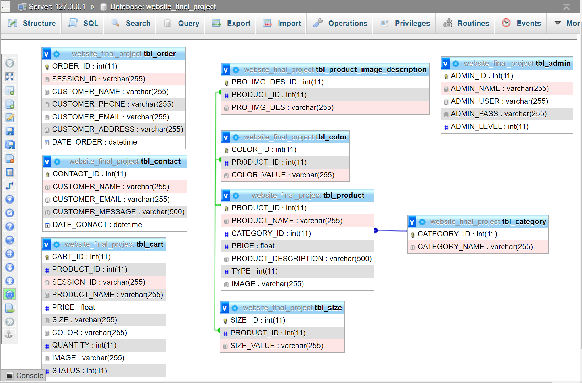

Slide 11
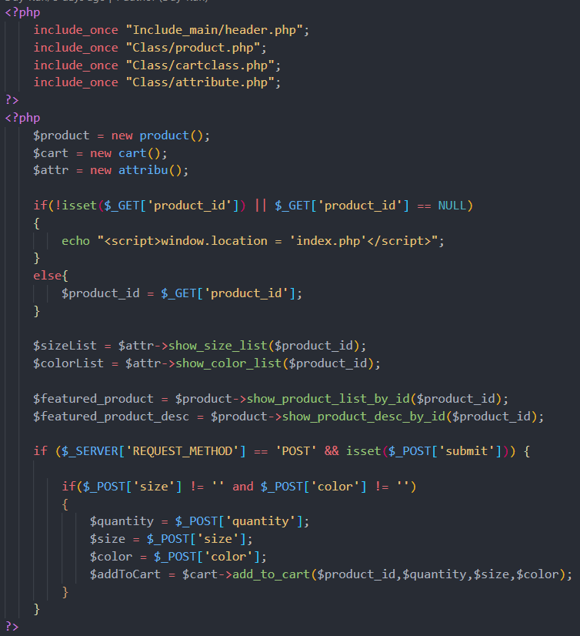
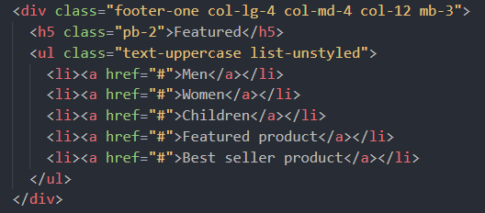
PRODUCT
OPTIONS
3 main categories of our products, namely for Men, for Women and for Children
products with attributes: color + size + quantity

Slide 12


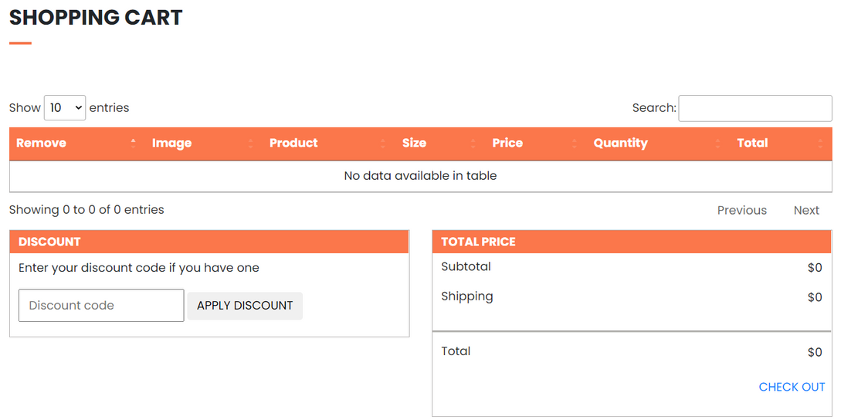
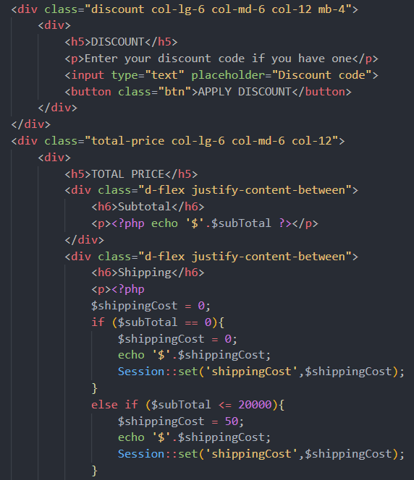
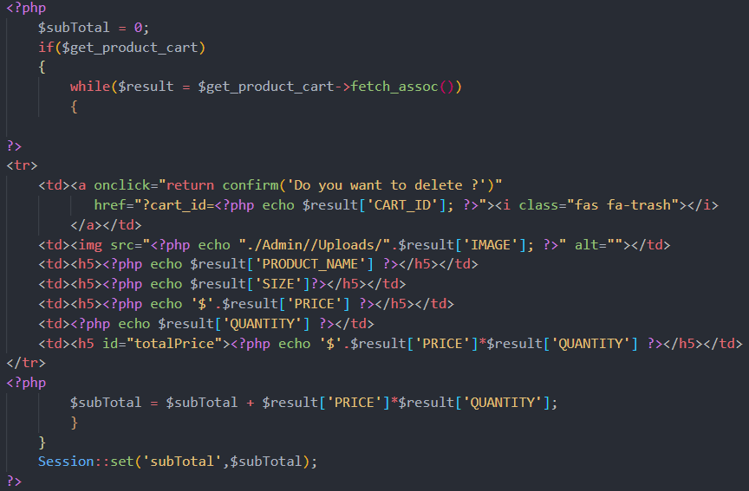
ORDER TRACKING
where customers can see and manage their orders

Slide 13


